Slide 1

Verilog HDL (Behavioral Model)
Winter 1400 (Computer Aided Design)
Meisam Abdollahi
School of Computer Engineering
Iran University of Science and Technology
meisam.abdolahi@ut.ac.ir

Slide 2
Modeling Hardware
The biggest difficulty is representing concurrently operating hardware.
It is needed to “simulate” the execution of several parts of the circuit at the same time.
Verilog models combinational circuits by what are called concurrent statements
These statements are evaluated any time and every time a signal on the right side of the statement changes.

Slide 3
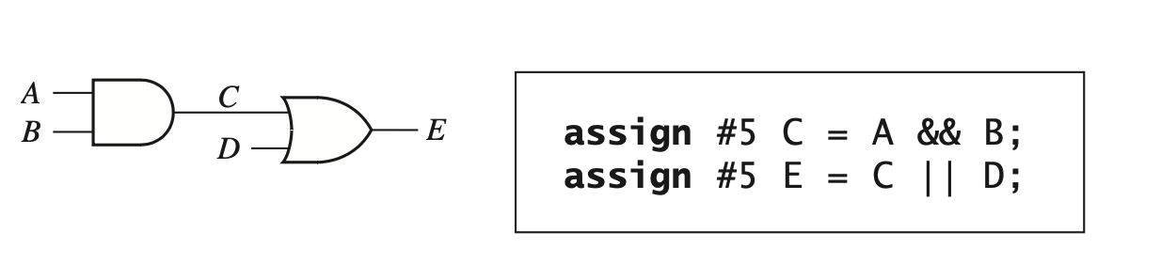
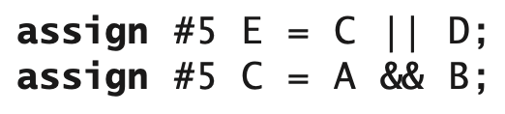
Concurrent Statement
The Verilog simulator monitors the right side of each concurrent statement, and any time a signal changes, the expression on the right side is immediately reevaluated after the defined delay.
Optional
The order is not importnat

Slide 4
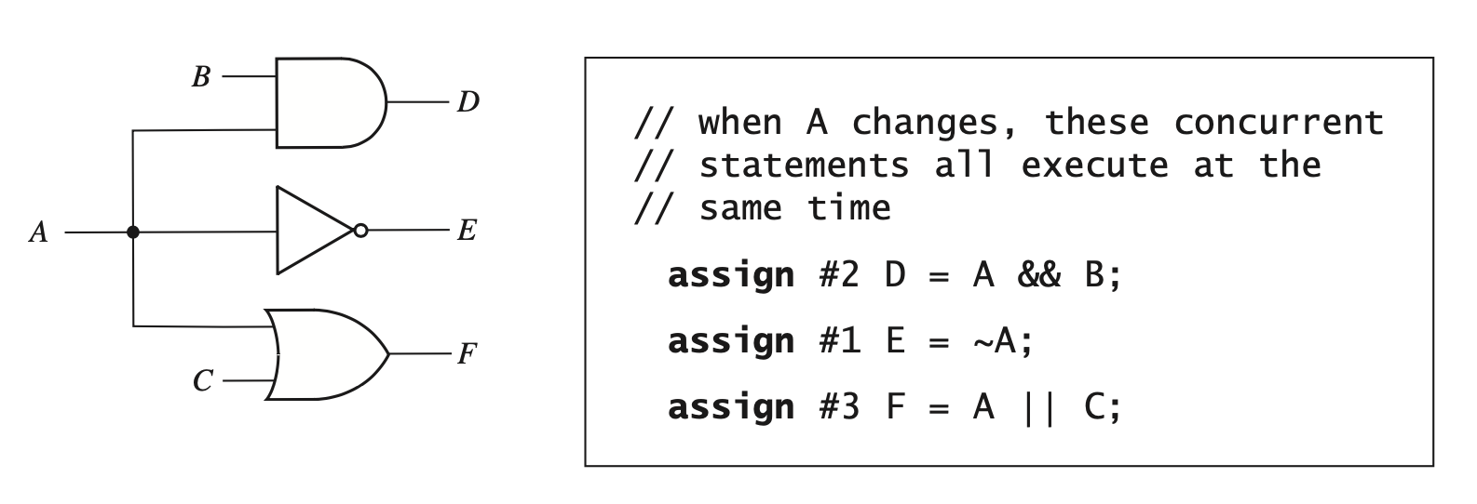
Concurrent Statement
Even though the statements execute simultaneously at 5ns, the signals D, E, and F are updated at times 7 ns, 6 ns, and 8 ns.

Slide 5
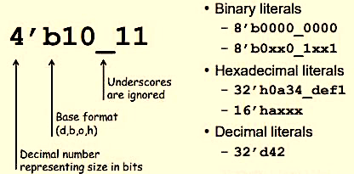
Net Values
Every signal is of type wire (or net), and it generally has a value of 0 or 1.
In general, the net values in Verilog are represented as <number of bits>’<base><value>.
The values on nets can be represented as binary, decimal, or hexadecimal indicated by b, d, and h respectively.

Slide 6
Vectors
In digital design, we often need to perform the same operation on a group of signals.
A one-dimensional array of bit signals is referred to as a vector.
wire B[3:0];
The statement B = 4'b1100 assigns 1 to B[3], 1 to B[2], 0 to B[1], and 0 to B[0].

Slide 7
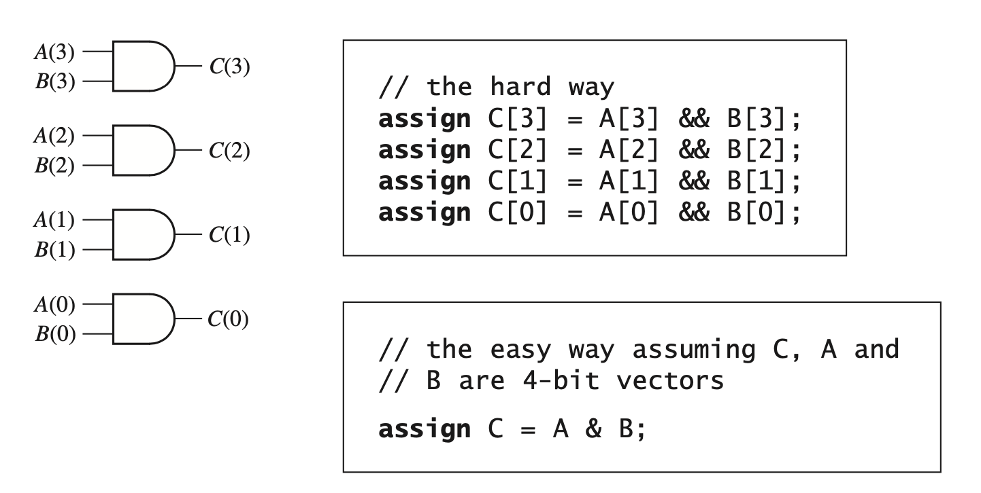
Vectors

Slide 8
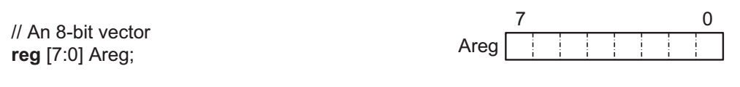
Arrays
Verilog allows declaration and usage of multidimensional arrays for nets or regs.
reg [7:0] a_array [0:1023][0:511];
the element size
the address range

Slide 9
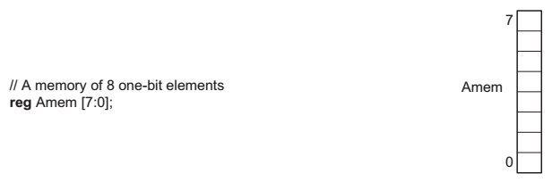
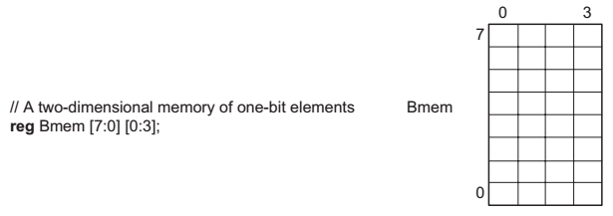
Arrays

Slide 10
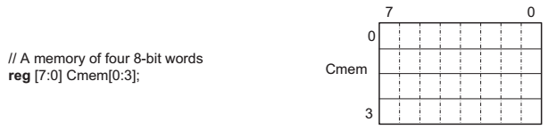
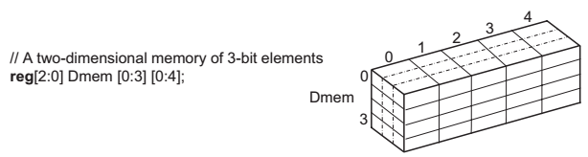
Arrays

Slide 11
Array Indexing
Bit-select and part-select operators are used for extracting a bit or a group of bits from a declared array.
Bit selection : Bit-selection is done by using the addressed bit number in a set of square brackets.
Areg [5] bit 5 of the Areg array.
Part selection : A constant part-select specifies range of bits to be selected.
Areg [7:3] the upper five bits of Areg.
Starting index
Areg [5 - : 3]
bits 5 , 4 , 3
Direction
Number of bits

Slide 12

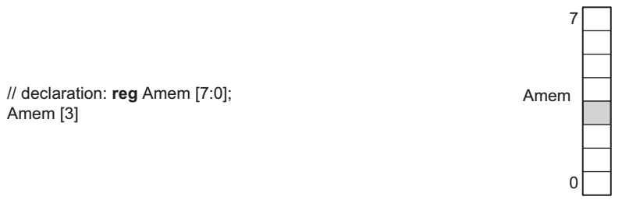
Array Indexing

Slide 13
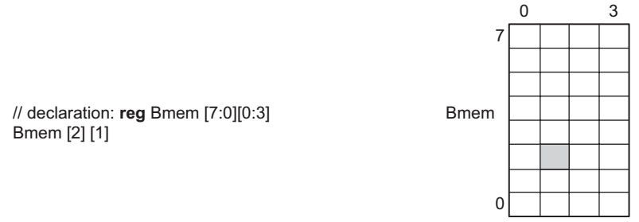
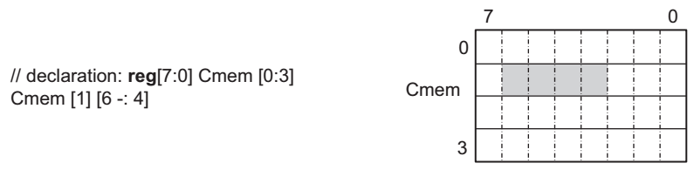
Array Indexing

Slide 14
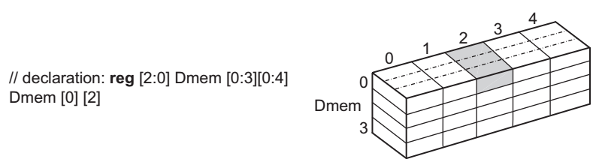
Array Indexing
Emem [Emem[0]] // addresses Emem by Emem[0]
Emem [355][3-:4] // 4 bits starting from 3, down

Slide 15
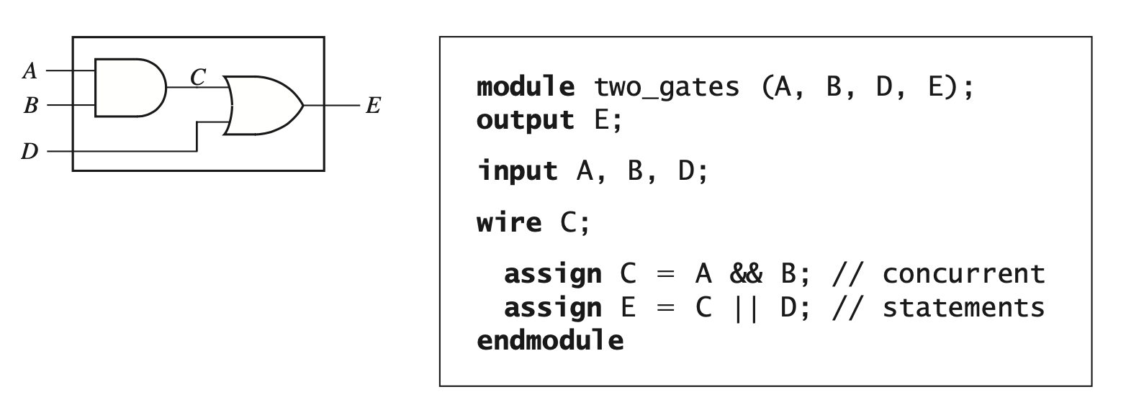
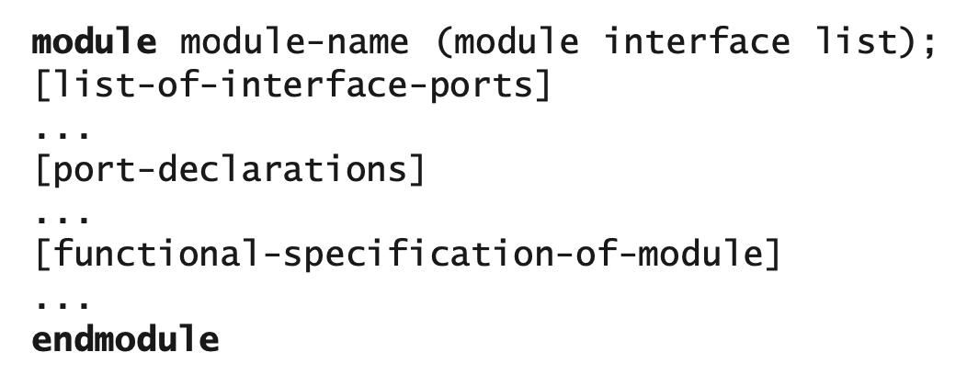
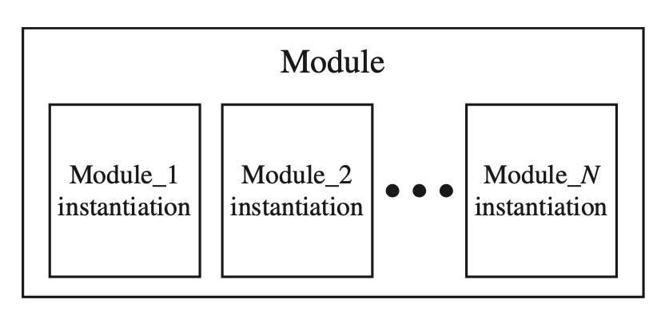
Verilog Modules

Slide 16
Verilog – Structural models of combinational Logic
Top Down Design and Nested Modules

Slide 17
Verilog – Structural models of combinational Logic
Top Down Design and Nested Modules

Slide 18
Verilog – Structural models of combinational Logic
Top Down Design and Nested Modules
module Half_Adder(sum , cout , a , b);
input a , b;
output sum , cout;
xor (sum , a , b);
and (cout , a , b);
endmodule
outputs are of wire type by default

Slide 19
Verilog – Structural models of combinational Logic
Top Down Design and Nested Modules
module Full_Adder (sum , c_out , a , b , c_in );
output sum, c_out;
input a, b, c_in;
wire w1 , w2 , w3;
Half_Adder M1 (w1 , w2 , a , b);
Half_Adder M2 (sum , w3 , c_in , w1);
or (c_out , w2 , w3);
endmodule

Slide 20
Verilog – Structural models of combinational Logic
Top Down Design and Nested Modules
module RCA_Adder_4(sum,cout,a, b,cin);
output [3: 0] sum;
output cout;
input [3: 0] a, b;
input cin;
wire cin1, cin2, cin3; // wire [3:1] C;
Full_Adder M1 (sum[0], cin1, a[0], b[0], cin);
Full_Adder M2 (sum[1], cin2, a[1], b[1], cin1);
Full_Adder M3 (sum[2], cin3, a[2], b[2], cin2);
Full_Adder M4 (sum[3], cout, a[3], b[3], cin3);
endmodule

Slide 21
Positional Vs Named Association
module RCA_Adder_4(sum, cout, a, b, cin);
output [3: 0] sum;
output cout;
input [3: 0] a, b;
input cin;
wire cin1, cin2, cin3; // wire [3:1] C;
Full_Adder M1 (sum[0], cin1, a[0], b[0], cin);
Full_Adder M2 (sum[1], cin2, a[1], b[1], cin1);
Full_Adder M3 (sum[2], cin3, a[2], b[2], cin2);
Full_Adder M4 (sum[3], cout, a[3], b[3], cin3);
endmodule
Positional Association
module RCA_Adder_4(sum, cout, a, b, cin);
output [3: 0] sum;
output cout;
input [3: 0] a, b;
input cin;
wire cin1, cin2, cin3; // wire [3:1] C;
Full_Adder M1(.cout(cin1), .a(a[0]), .sum(sum[0]), .cin(cin), .b(b[0]));
Full_Adder M2(.cout(cin2), .a(a[1]), .sum(sum[1]), .cin(cin1), .b(b[1]));
Full_Adder M3(.cout(cin3), .a(a[2]), .sum(sum[2]), .cin(cin2), .b(b[2]));
Full_Adder M4(.cout(cout), .a(a[3]), .sum(sum[3]), .cin(cin3), .b(b[3]));
endmodule
Named Association

Slide 22
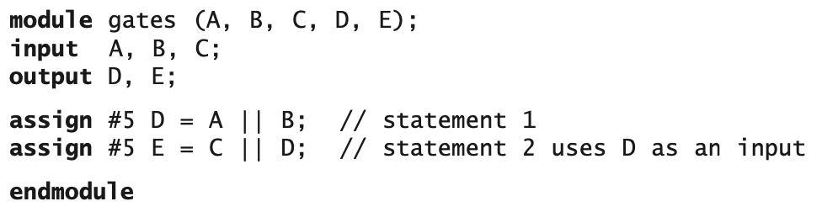
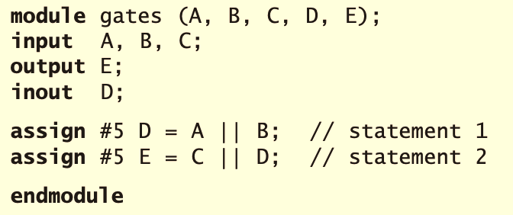
Use of “Inout” Mode
In VHDL, D should be strictly in either in or inout mode, but Verilog is not that strict in compilation.

Slide 23
Verilog Assignments
wire C; assign C = A || B; // explicit continuous assignment
wire D = E && F; // implicit continuous assignment
Continuous assignments are used to assign values for combinational logic circuits.
Procedural assignments are used to model registers and finite state machines using the always keyword.

Slide 24
Procedural Assignments
Combinational logic constantly reacts to input changes.
In contrast, synchronous sequential logic responds to changes dependent on the clock.
Many input changes might be ignored since output and state changes occur only at valid conditions of the clock.
Modeling sequential logic requires
-primitives to model selective activity conditional on clock
edge-triggered devices
sequence of operations, and so forth.

Slide 25
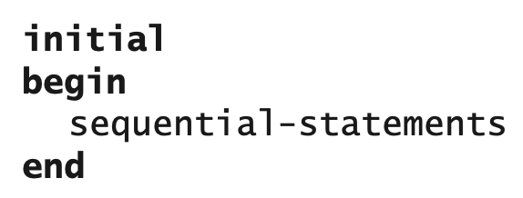
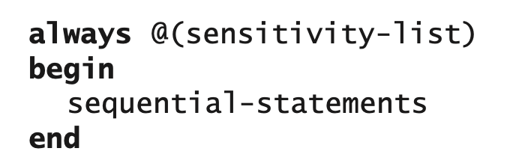
Procedural Assignments
There are two types of procedural assignments in Verilog.
Initial blocks execute only once at time zero
always blocks loop to execute over and over again.
Initial blocks are useful in simulation and verification, but only always blocks are synthesized.

Slide 26
Always Block
the statements between the begin and the end are executed sequentially rather than concurrently.
Whenever one of the signals in the sensitivity list changes, the sequential statements in the always block are executed in sequence one time.
When a process finishes executing, it goes back to the beginning and waits for a signal on the sensitivity list to change again.
The variables on the left-hand side element of an = or <= in an always block should be defined as reg data type. Any other data type including wire is illegal.

Slide 27
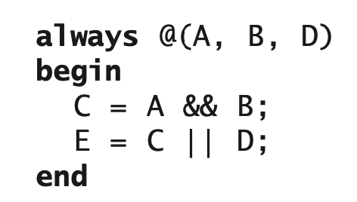
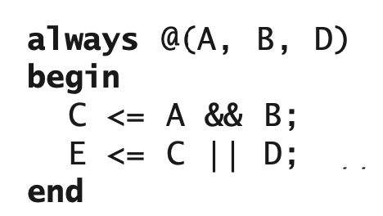
Blocking & Non-Blocking Assignments
Sequential statements can be evaluated in two different ways in Verilog: blocking and non-blocking assignments.
Blocking Assignment:
in a blocking statement, the evaluation of the right-hand side of a statement must be completed before the next statements in a sequential block are executed.
it blocks the next assignment in the sequential block from starting evaluation
Operator “=” is used for representing the blocking assignment.
Non-Blocking Assignment:
A non-blocking statement allows assignment evaluation without blocking the sequential flow.
Several assignments can be evaluated at the same time. Operator “<=” is used for representing the non-blocking assignment.

Slide 28
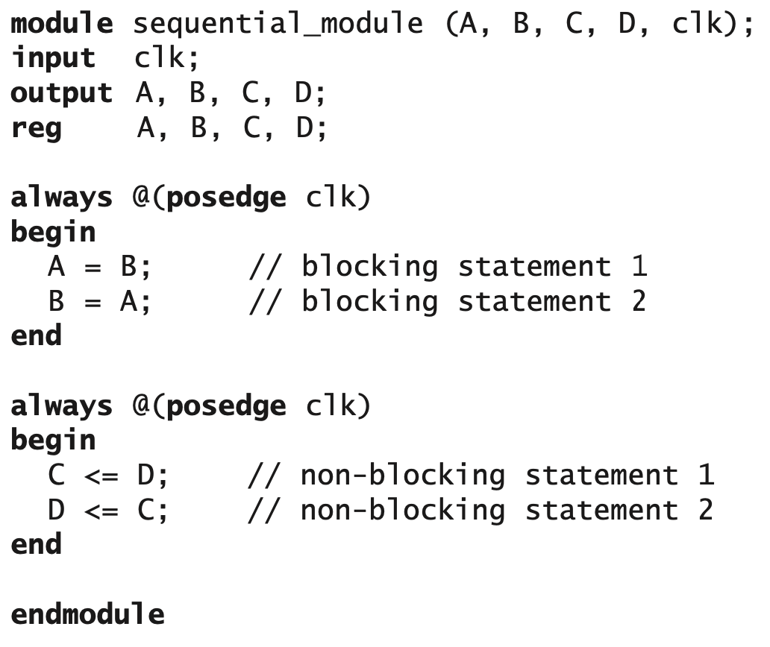
Blocking & Non-Blocking Assignments
Initial Values:
A=C=1’b1
B=D=1’b0
A=B=1’b0
the signals don’t swap
C=1’b0
D=1’b1
the signals swap

Slide 29
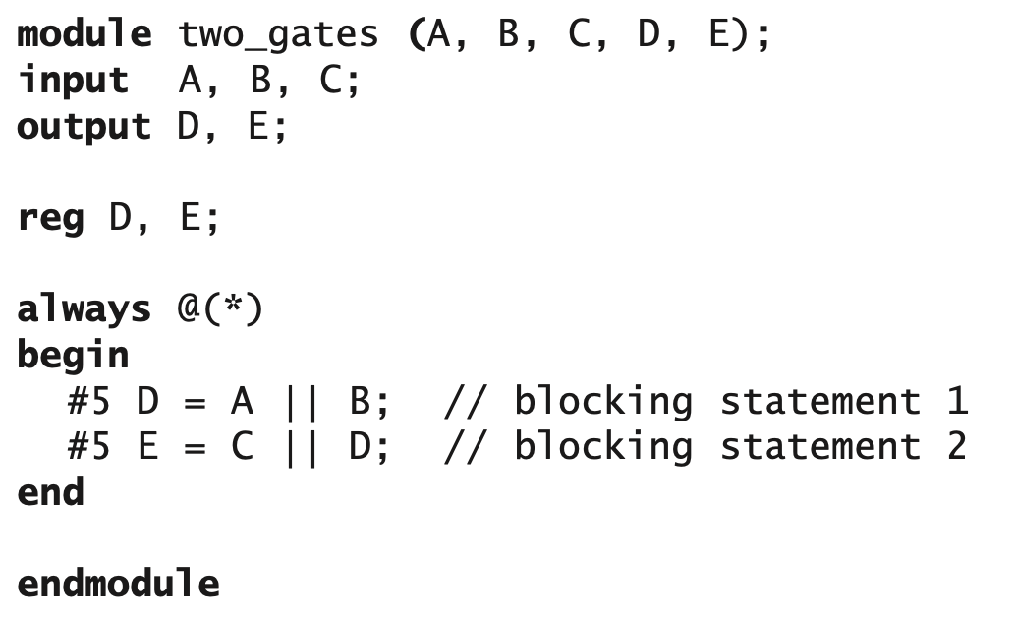
Always Block for Combinational Cirsuits
Always blocks are required for modeling sequential logic, however, they can be used also to model combinational logic.
One should be very careful when using always statements to represent combinational logic.
some of the input signals might be accidentally omitted from the sensitivity list!!
To avoid this problem, a common practice is to use the always @* statement if a combinational circuit is desired
If the sensitivity list is “*” then the block will get triggered for any input signal changes.
A good coding practice for writing synthesizable code
Use non-blocking assignments (i.e., “<=”) in always blocks intended to create sequential logic
Use the blocking assignments “=” in always blocks intended to create combinational logic.
reg is the only legal type on the left-hand of an assignment in an always block.
A
D
E
10
15
20

Slide 30
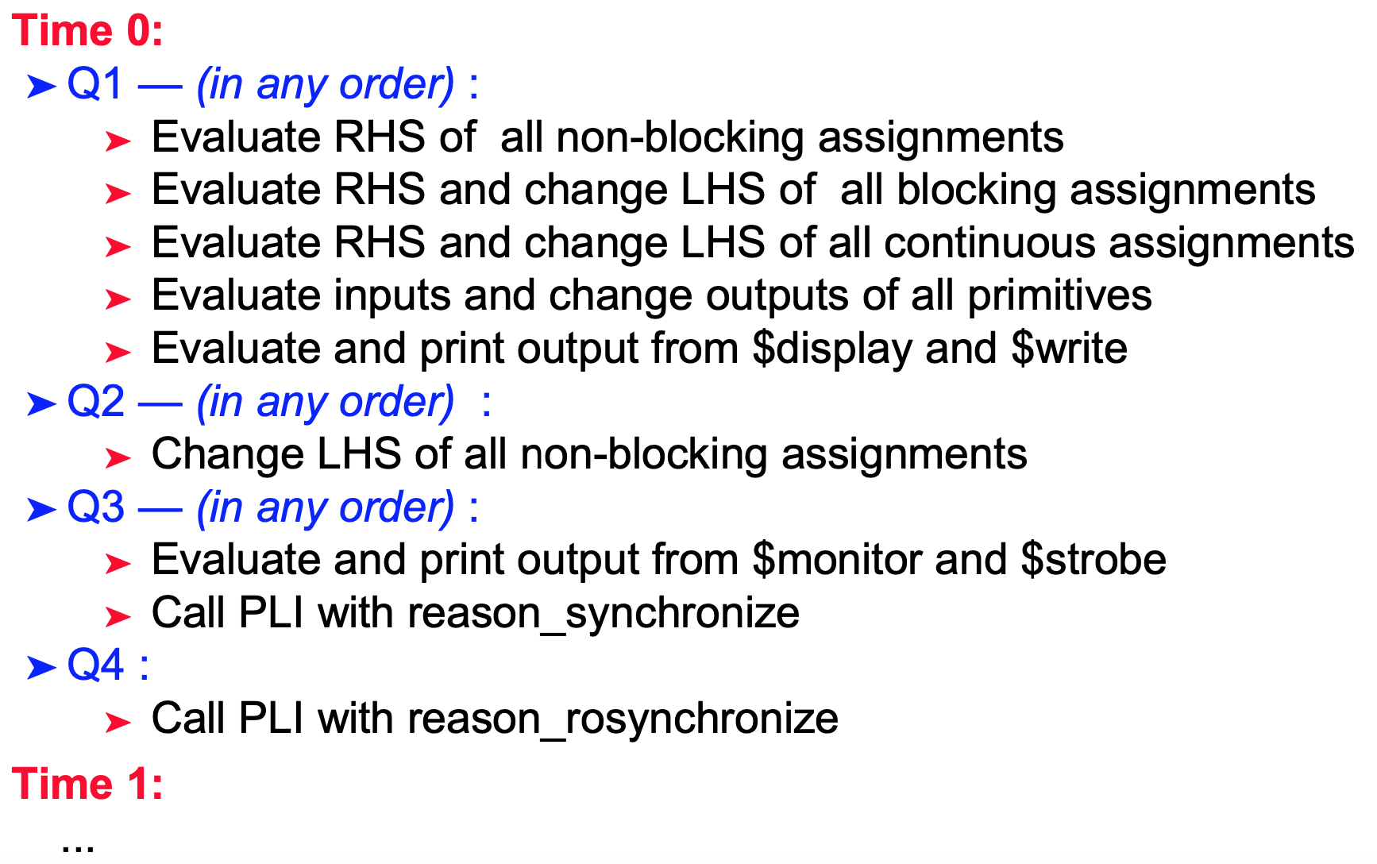
Time representation in Verilog Simulation
Each Verilog simulation time step is divided into 4queues:

Slide 31
Determinism in Verilog
Based on the event queue diagram we can make some obvious conclusions about determinism.
Statements within a begin…end block is evaluated sequentially.
The current block execution could get suspended for the execution of other active process blocks, but the execution order of any begin...end block does not change in any circumstances.
nonblocking assignment LHS update will always happen after the blocking assignments even if the blocking assignment appears later in the begin...end order.

Slide 32
Example:
initial begin x = 0 y <= 3 z = 8 end
initial begin x = 0 y <= 3 z = 8
p <= 6 end
1
Evaluation and Assignment
1
Evaluation and Assignment
2
RHS Evaluation y<=3
2
RHS Evaluation Only
3
Evaluation and Assignment
3
Evaluation and Assignment
2
RHS Evaluation p<=6
4
RHS Assignment of y<=3
4
RHS Assignment of y<=3
4
RHS Assignment of p<=6

Slide 33
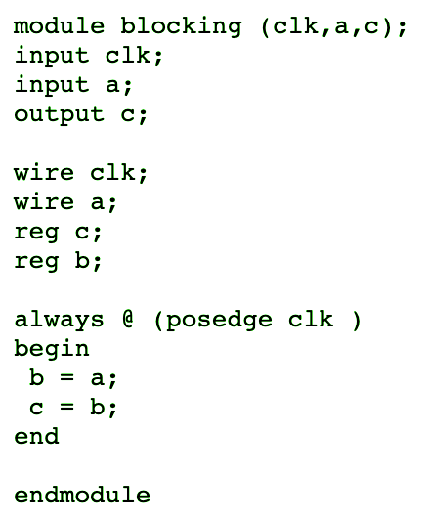
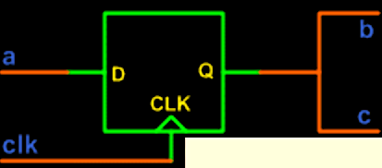
Blocking Assignmnets in Always Blocks

Slide 34
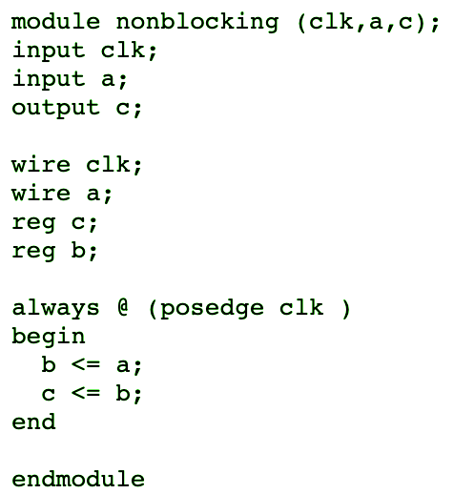
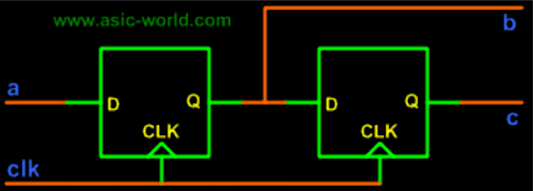
Non-Blocking Assignmnets in Always Blocks

Slide 35
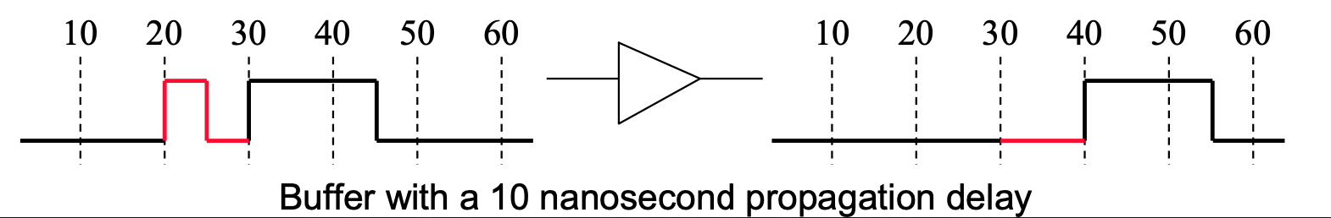
Inertial Delay
Inertial delay is a measure of the elapsed time during which a signal must persist at an input of a device in order for a change to appear at an output.
A pulse of duration less than the inertial delay does not contain enough energy to cause the device to switch.

Slide 36
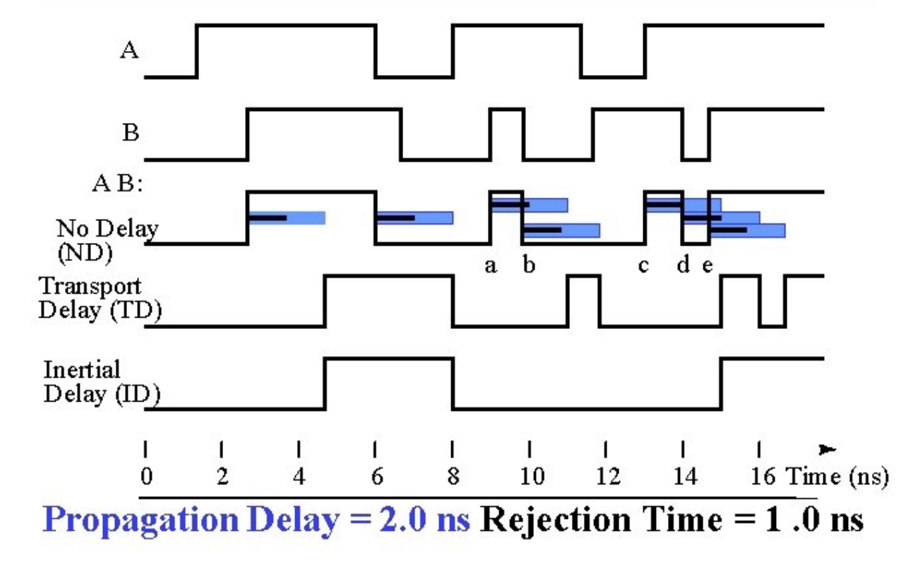
Transport Delay
Transport delay is the time duration between having a change in the input of a device and having a change in the output in response to the input change.

Slide 37
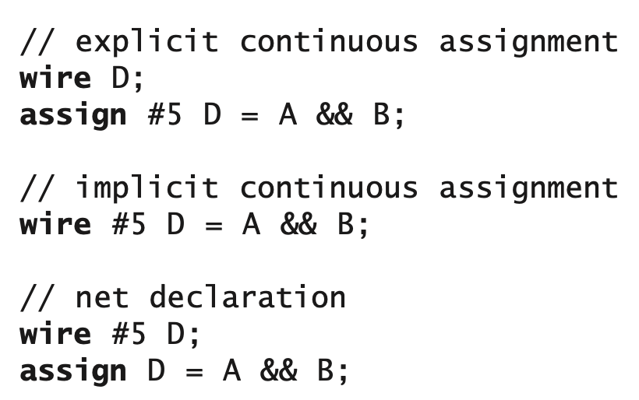
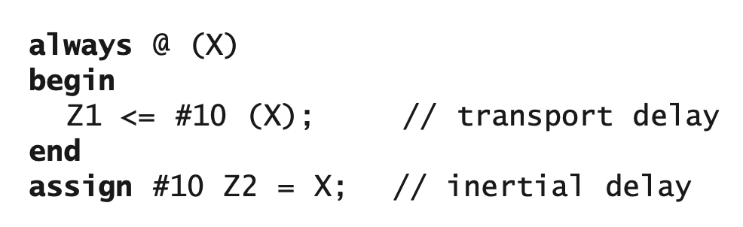
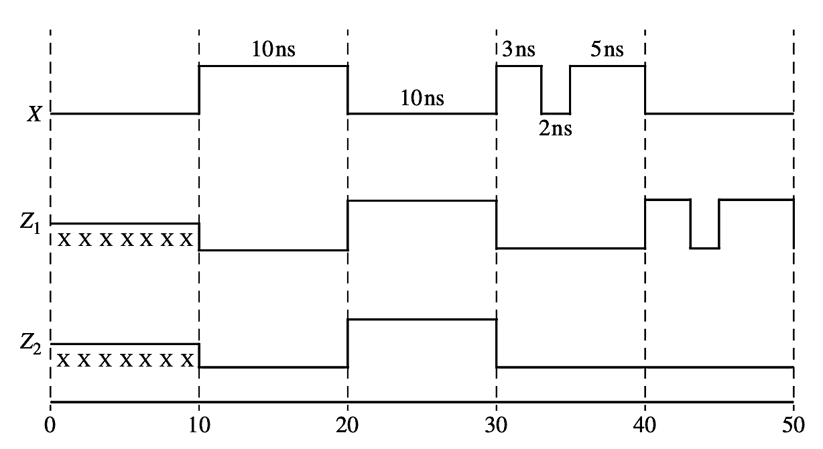
Inertial and Transport Delay in Verilog
Delayed Assignment
Delayed Evaluation
The placement of the delay on the right-hand side cannot be done with continuous assign statements.
❌ assign A = #10 B; //illegal, compile error

Slide 38
Procedural Assignment: Sequential
always @(posedge clk) begin
A = 1; #5 B = A + 1;
end
evaluate and assign A immediately; wait for 5 units of time, then evaluate and assign
always @(posedge clk) begin
A <= 1; #5 B <= A + 1;
end
evaluate A immediately;
assign at end of time step; delay 5 time units, then evaluate; then assign at end of time step (clock + 5)

Slide 39
Procedural Assignment: Concurrent
Concurrent blocking assignments have unpredictable results:
always @(posedge clk)
#5 A = A + 1;
always @(posedge clk)
#5 B = A + 1;
Concurrent non-blocking assignments have predictable results
always @(posedge clk)
#5 A <= A + 1;
always @(posedge clk)
#5 B <= A + 1;
Unpredictable Result:
(new value of B could be evaluated before or after A changes)
Predictable Result:
(new value of B will always be evaluated before A changes)

Slide 40
Delayed Procedural Assignment: Inter-Assignment
A timing control before an assignment statement will postpone when the next assignment is evaluated
Evaluation is delayed for the amount of time specified
begin #5 A = 1; #5 A = A + 1;
B = A + 1;
end
delay for 5, then evaluate and assign delay 5 more, then evaluate and assign no delay; evaluate and assign

Slide 41
Delayed Procedural Assignment: Intra-Assignment
An intra-assignment delay places the timing control after the assignment token
➤ The right-hand side is evaluated before the delay
➤ The left-hand side is assigned after the delay
always @(A)
B = #5 A;
always @(negedge clk) Q <= @(posedge clk) D;
A is evaluated at the time it changes, but is not assigned to B until after 5 time units
D is evaluated at the negative edge of CLK, Q is changed on the positive edge of CLK
always @(negedge clk) Q <= repeat(8)@(posedgeclk) D;
The value of IN is evaluated when it changes, but is not assigned to OUT until after 8 clock cycles

Slide 42
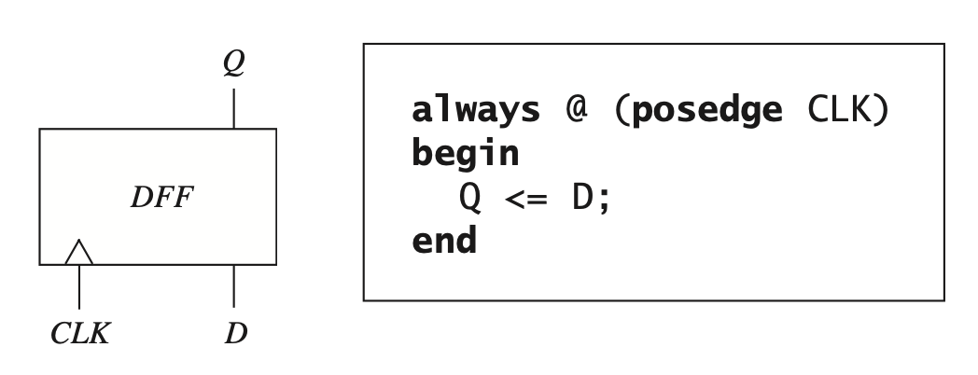
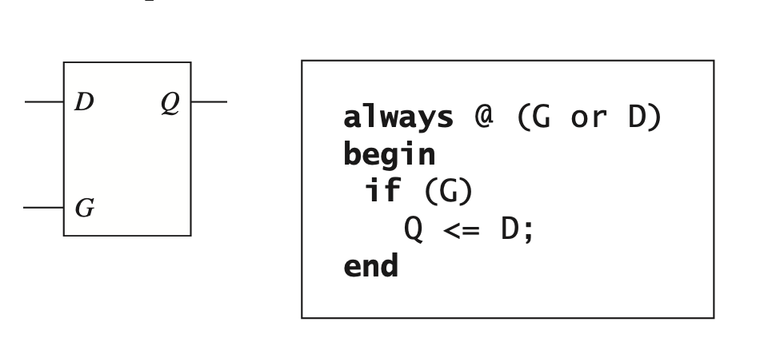
Modeling Flip-Flops and Latches Using Always Block
FF
Latch
Question: design an FF with delay of 5ns between the rising edge of the clock and the change in the Q output

Slide 43
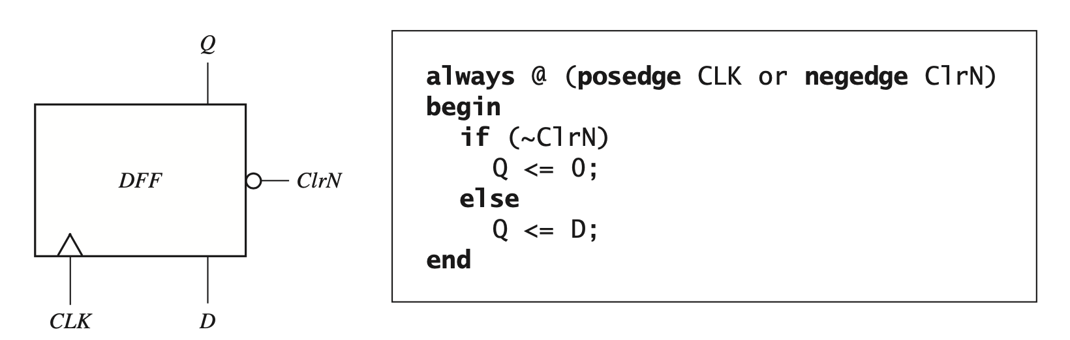
D Flip-Flop with Asynchronous Clear

Slide 44
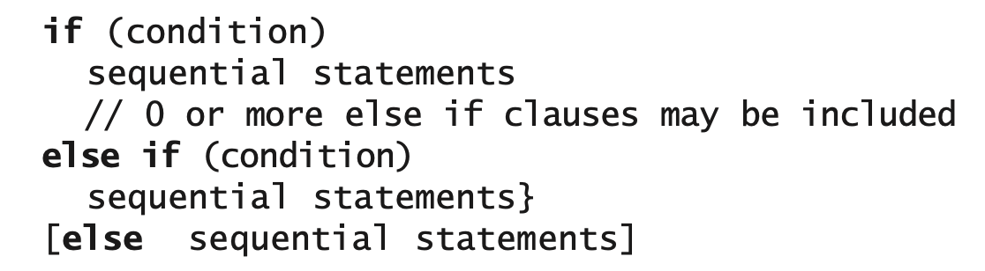
IF Statement
Verilog if statements are sequential statements that can be used within an always block (or an initial block), but they cannot be used as concurrent statements outside of an always block.

Slide 45
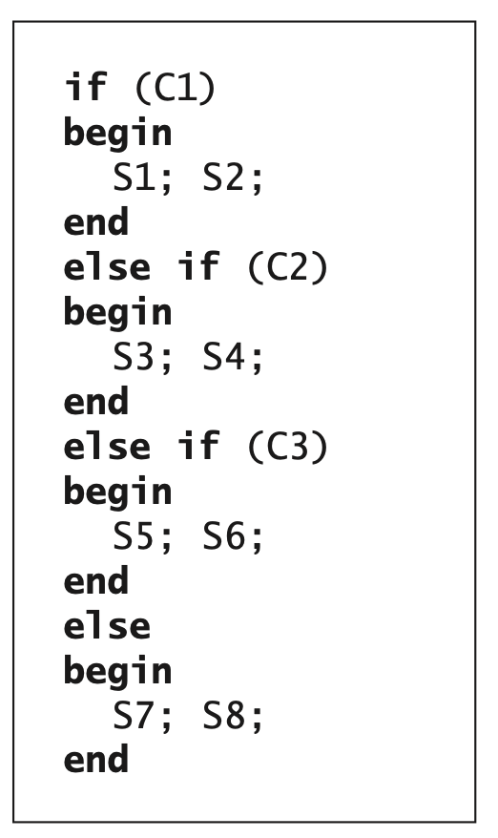
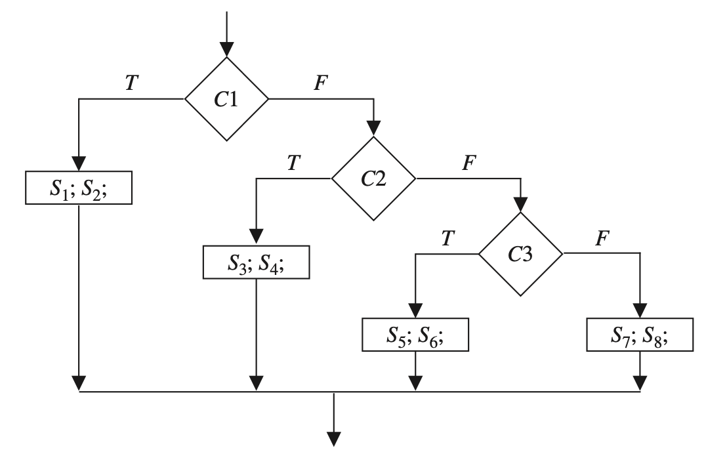
IF Statement

Slide 46
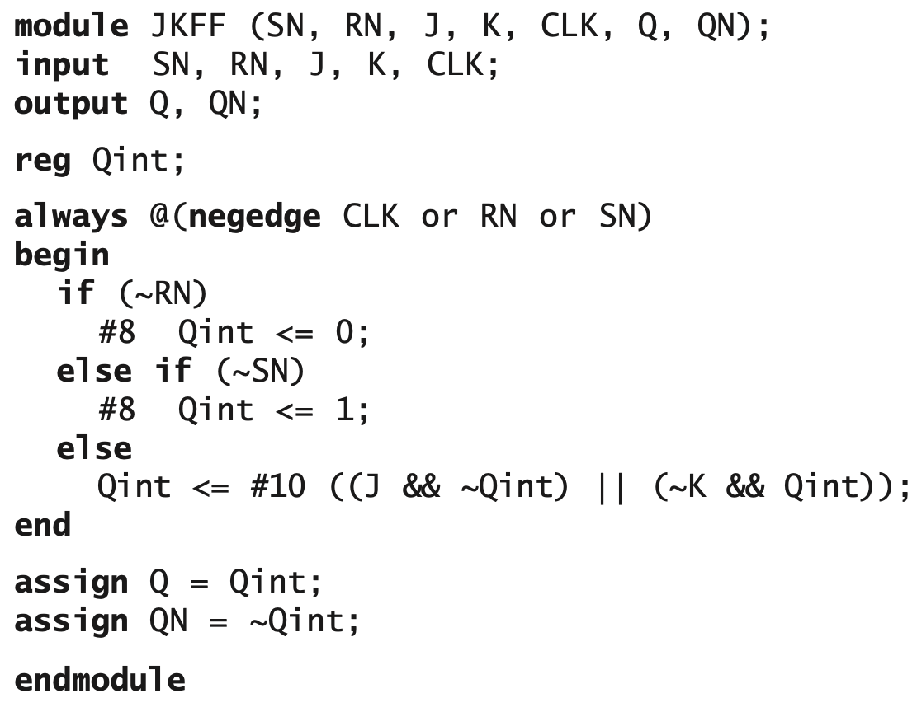
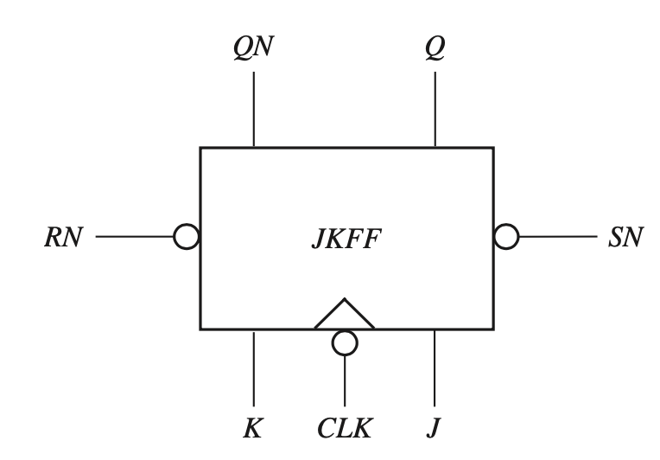
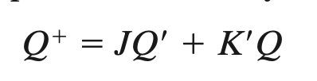
JK Flip flop Model

Slide 47
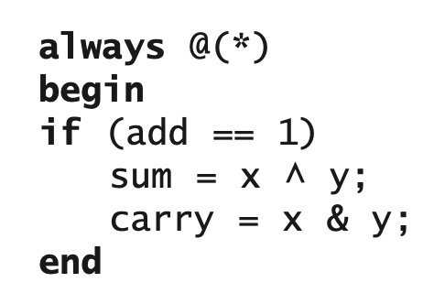
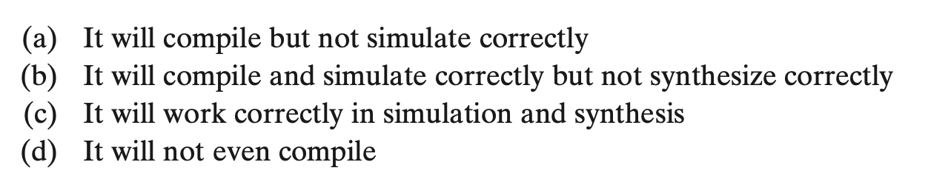
Example 1
What is wrong with the following code for a half adder?
The if statement is missing begin and end. Only the sum is part of the if statement.
This can be corrected by adding begin and end for the if statement. It can still lead to latches in synthesis.
Latches can be avoided by adding else clause or by initializing sum and carry to 0 at the beginning of the always statement.

Slide 48
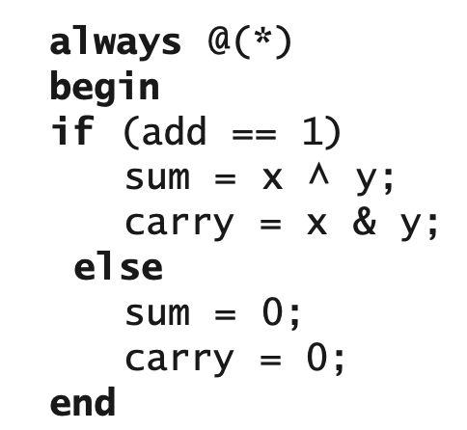
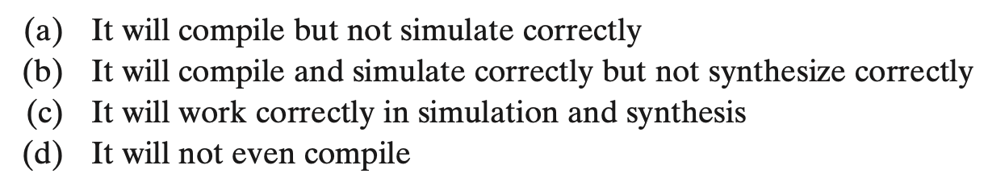
Example 2
What is wrong with the following code for a half adder?

Slide 49
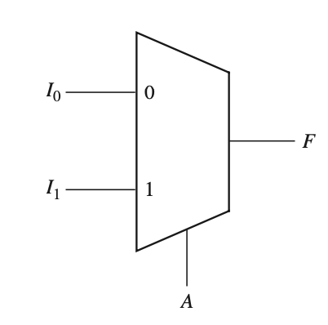

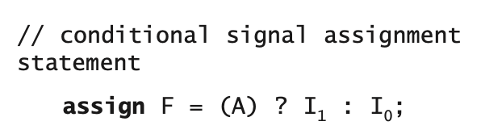
Verilog Models for Multiplexers
Genral Form of a Conditional Statement
1
2

Slide 50


Cascaded 2-to-1 MUXes Using Conditional Assignment

Slide 51

4-to-1 Multiplexer

Slide 52



Using If-else or Case Statement in an Always Block
All possible values of the expression must be included in the choices.
If all values are not explicitly given, a default clause is required in the case statement.

Slide 53


Always Blocks Using Event Control
An alternative form for an always block uses wait or event control statements instead of a sensitivity list.
If a sensitivity list is omitted at the always keyword, delays or time- controlled events must be specified inside the always block.
An always block cannot have both wait statements and a sensitivity list.

Slide 54


Wait Statement
A procedural statement waits when the Boolean expression is FALSE. When the expression is TRUE, the statement is executed.
The logic values 0, ‘x’, and ‘z’ are treated as FALSE. Logic 1 is TRUE.
The wait statement can also be used to handshake or synchronize two concurrent processes

Slide 55
Compilation, Simulation, and Synthesis of Verilog Code
Compiler
(Analyzer)
Elaborator
Simulator
read every HDL file and check that the syntax is correct.
Every language has a LRM, a Language Reference Manual that defines the syntax that is valid.
the interconnections among the port signals are specified
Checks if the design and testbench is connected up in the right way.
A driver is created for each signal holding current value of a signal and a queue of future signal values.
The simulation process consists of an initialization phase and actual simulation.
threads of execution or processes
Verilog simulation uses what is known as discrete event simulation.

Slide 56
Simulation
Processes include modules, initial and always procedural blocks, continuous assignments, procedural assignment statements, system tasks, and so forth.
Processes are sensitive to update events.
When an update event is executed, all the processes that are sensitive to that event are evaluated in an arbitrary order.
Events can occur at different times. In order to keep track of the events, the events are kept on an event queue, ordered by simulation time.
Putting an event on the queue is called scheduling an event.

Slide 57
Verilog event queue
Events that occur at the current simulation time are in this region.
Events can be added to any of the five regions but can be removed only
Events can be processed in any order from within this region.
Active event
Events that occur at the current simulation time but that shall be processed after all the active events are processed
Blocking assignments with zero delays
Inactive event
Events that have been evaluated during some previous simulation time but that shall be assigned at this simulation time after all the active and inactive events are processed are in this region.
Non-blocking assign update
Events that shall be processed after all the active, in-acive, and non-blocking assign update events are processed are in this region. These are the monitor events.
Monitor event
Future event
Events that occur at some future simulation time are in this region. Future events are divided into future inactive events and future non-blocking assignment update events.

Slide 58

Simulation Cycle
The processing of all the active events is called a simulation cycle. For each simulation time, the following actions are performed in order:

Slide 59
Simulation with Multiple Processes
If a model contains more than one process, all processes execute concurrently with other processes.
If there are concurrent statements outside always statements, they also execute concurrently.
Statements inside of each always block execute sequentially.
A process takes no time to execute unless it has wait statements in it.

Slide 60





Example
Non-Blocking Assignent
Future Eveent Queue

Slide 61


Example Cont’d

Slide 62


Example: Sequential Design using Blocking Assignment
A single flip-flop
A 3-bit shift register

